Slide 1
Planning the future: Exit Strategies
EIT Digital Master School @Eötvös Lorand University
Business Development Lab
Inspired by www.exits.com &
Chapter 16 “Essential of Entrepreneurship and small business management” Pearson 7th edition &
Deenitchin, Iassen, and Piotr Pikul. Entrepreneurship: how to Design Growth and Exit Strategy. MBA Poznań-Atlanta, 2006.

Slide 2

Exit Strategy
An exit strategy is a way to turn you operation over to another entity or to cease operating altogether.

Slide 3
Exit Strategy
“Exit strategies are all laughable. The most common exit for young entrepreneurs is no exit at all, but rather failure or bankruptcy or liquidation. Given that’s the most high-probability exit scenario, it’s what they should focus on avoiding. The second most likely scenario is to continue to run the business. The third most likely exit is an acquisition. Going on to an IPO is a one-in-a-million shot for today’s typical entrepreneur.” Steven Gold

Slide 4
Exit Strategy
Beginning with the end in mind
Entrepreneurs need to acknowledge that no 100% predictable exit strategy exists
Still every fast-growing entrepreneur needs to define early on what his or her exit strategy will look like

Slide 5
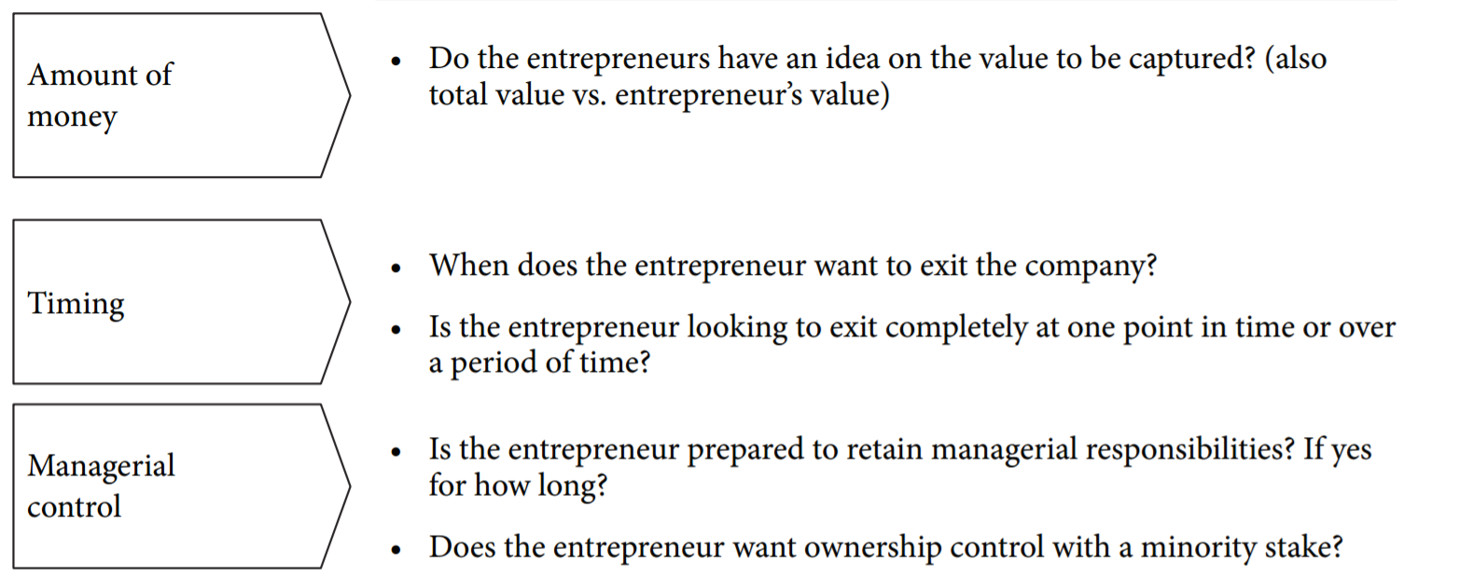
Issue to address for your Exit Strategy

Slide 6
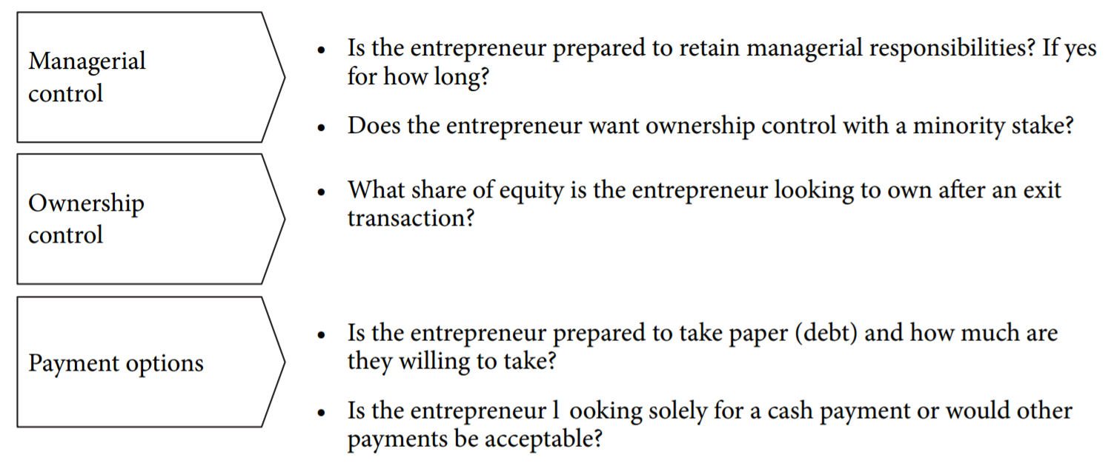
Issue to address for your Exit Strategy

Slide 7
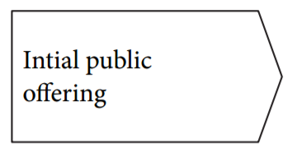
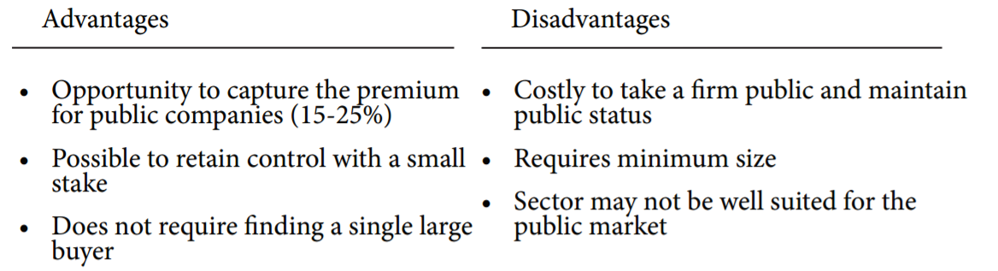
Exit Strategy: Sell

Slide 8
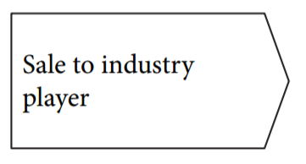
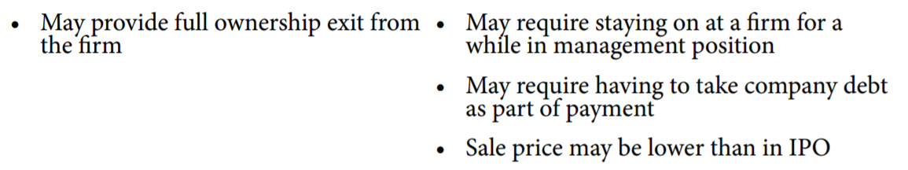
Exit Strategy: Sell

Slide 9
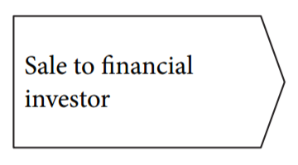
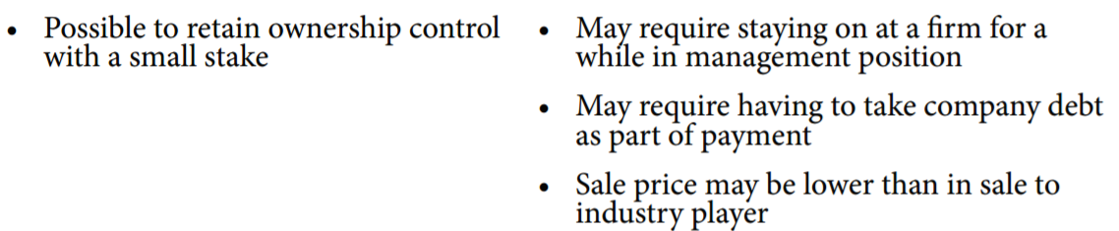
Exit Strategy: Sell

Slide 10
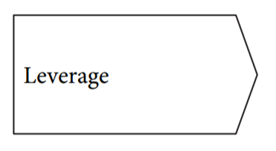
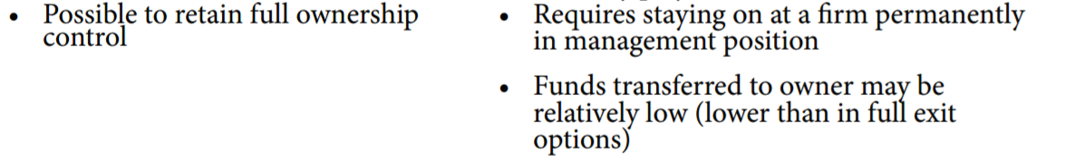
Exit Strategy: Stay

Slide 11
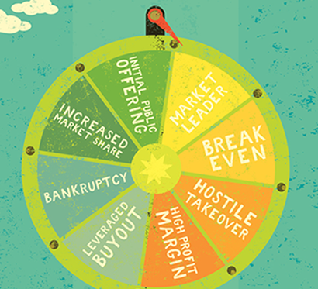
Exit Strategies In details
Management buyout (Insiders)
Mergers & Acquisitions (Outsiders)
Family succession/ Friendly Sale
Initial Public Offering (IPO)
Liquidation
The Lifestyle Company/Your cash cow

Slide 12

Management buyout

Slide 13

Management buyout: Owner perspective
If you want to see the business continued long consider turning to your employees.
They have determination to make it work.
And they will know:
how things are run
the company culture
long term goals

Slide 14

Mergers
&
Acquisitions

Slide 15
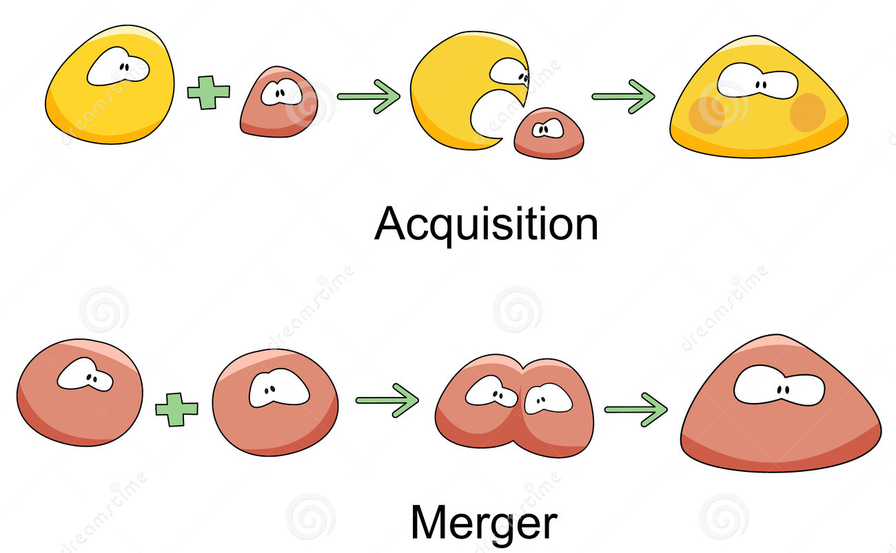
Mergers & Acquisitions: How and Why
This means merging with a similar company,
or being bought by a larger company.
Win-win situation: complementary skills, grow their revenue, expand market

Slide 16

Mergers & Acquisitions: Owner perspective
Sells the controlling interest in the business to another party
To leave the business gradually
Still assume a smaller role in the daily operation
May be powerless to prevent changes

Slide 17
Mergers & Acquisitions: Owner perspective
Pros
If you have strategic value they may pay far more
a bidding war can ratchet your price to the stratosphere
Cons
May prevent you from becoming attractive to other acquirers
Difficult when cultures and systems clash
Agreements and other strings that can be unpleasant

Slide 18

Friendly Sale

Slide 19
Friendly Sale
Sell to a friendly individual.
This is not an M&A: it is not combining two entities into one.
Great way to “cash out”, pay investors, pay yourself.
The ideal buyer has more:
skills
and interest
and chances to scale

Slide 20
Friendly Sale: Family
Owner may choose to sell her enterprise
the operation is passed from one family member to another.
takes comfort in knowing that his venture will operate in the same way that he conducted the business.

Slide 21
Friendly Sale: Family & Friends
Pros
You know them. They know you.
Will most likely preserve what's important to you
Cons
You can get so attached that you leave too much money on the table
Can tear the company apart with jealousies
Can tear private relationships

Slide 22
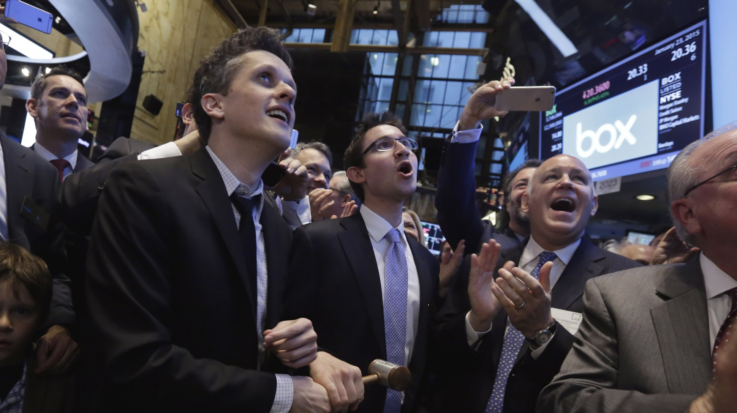
Initial Public Offering (IPO)

Slide 23
Initial Public Offering (IPO): How and Why
a privately-owned business decides to sell shares of stock to the public
highly profitable for the entrepreneur and investors
can generate a large amount of revenue in a short period of time
is a rare occurrence,
in 2010, 7000 publicly-held companies in the United States.

Slide 24

Initial Public Offering (IPO): How and Why
quick way to riches, but
the IPO rate has declined every year until 2010, now at about 15%
Tough for startups these days: Shareholders are demanding, and liability concerns are high.
https://www.quandl.com/data/RITTER/US_IPO_STATS-Historical-US-IPO-Statistics

Slide 25
Initial Public Offering (IPO): How and Why
For a long time the NASDAQ and Wall Street have been the main markets for European startups.
eDreams Odigeo, Zalando, or Rocket Internet have chosen the Madrid, Frankfurt or London stock exchanges
More and more companies are taking longer to IPO
There is more capital available in the startup market

Slide 26
Initial Public Offering (IPO): How and Why
Pros
You'll be on the cover of Newsweek.
Your stock will be worth in the tens of millions of dollars.
Your VCs will finally stop bugging you
Cons
Only a very few number have this option
You need financial and accounting rigor from day one
Will require a reorganization before
You'll spend your time selling the company, not running it.

Slide 27
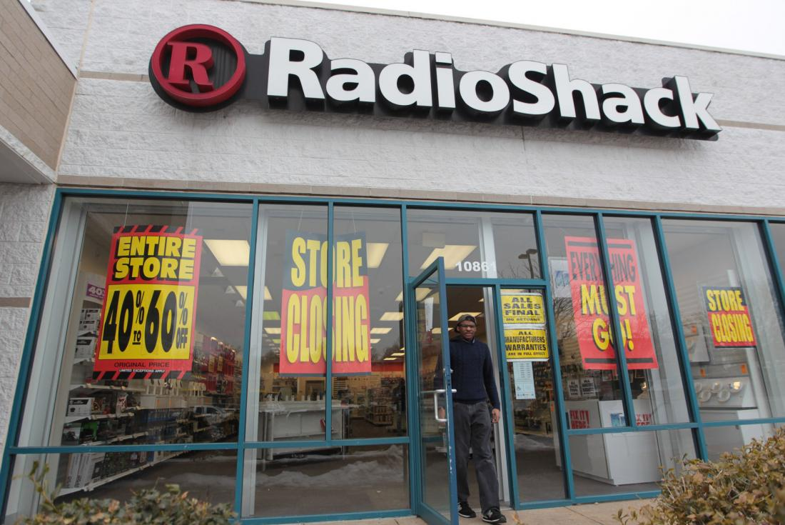
Liquidation

Slide 28
Liquidation
Businesses that are struggling to survive
ex."going out of business sale."
marks down the prices of its inventory to sell it quickly.
Any proceeds are used to pay off creditors, and shareholders

Slide 29
Liquidation and close
One often-overlooked exit strategy:
Simply to shutdown and liquidate.
Good in case of natural catastrophe, or the market you counted on could implode.
Make rules up front so you don’t end up going down with the ship.

Slide 30
Liquidation and close
Pros
There's no negotiations involved.
There's no worrying about transfer of control.
Cons
Get real; it's a waste!
clients, your reputation, and your business relationships may be very valuable, and liquidation just destroys them.
Other shareholders may be less than thrilled

Slide 31

The Lifestyle Company

Slide 32
The Lifestyle Company
to make as much money as possible
without planning for future expansion.
All profits go directly into owner pocket instead of being put back into the business
private and small in scale,
and the owner dissolves the operation when it no longer is profitable
Ex. a business consulting firm.

Slide 33

Cash Cow

Slide 34
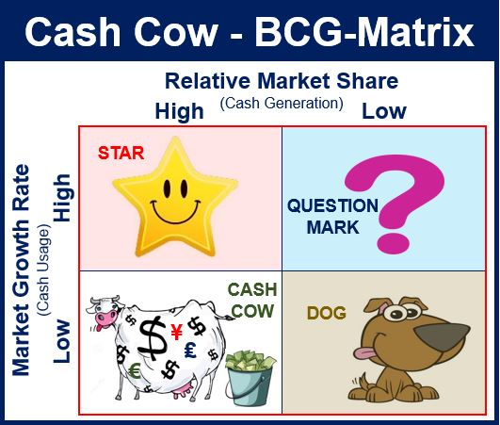
Do you know this one?
Boston Consulting Group
analysis, portfolio diagram

Slide 35
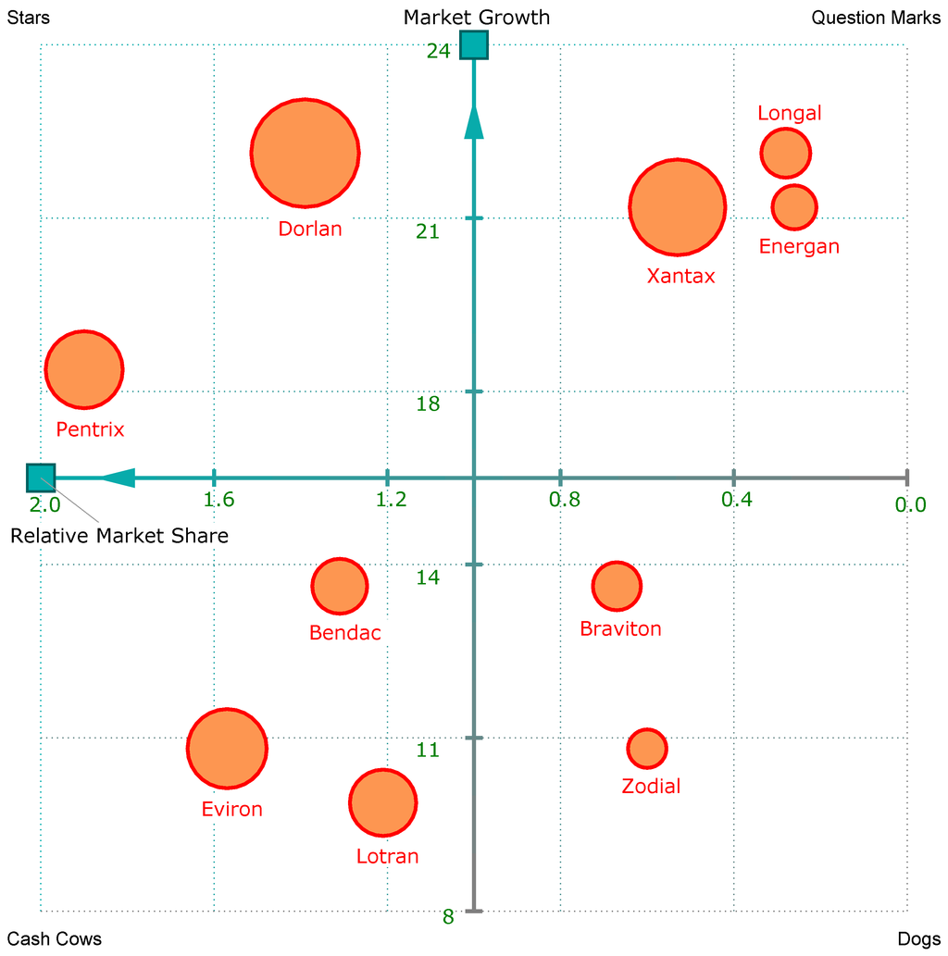

Slide 36
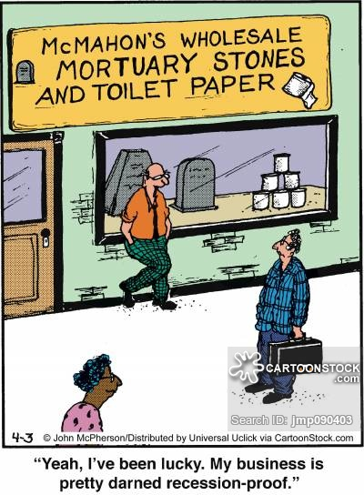
Cash Cow Business
stable, secure marketplace,
steady revenue stream, pay off investors,
Make it your cash cow!

Slide 37
Cash Cow: How and Why
someone you trust to run it for you, while you use the remaining cash to develop your next great idea.
You retain ownership and enjoy the annuity.
But cash cows seem to need constant feeding to stay healthy!

Slide 38


Slide 39
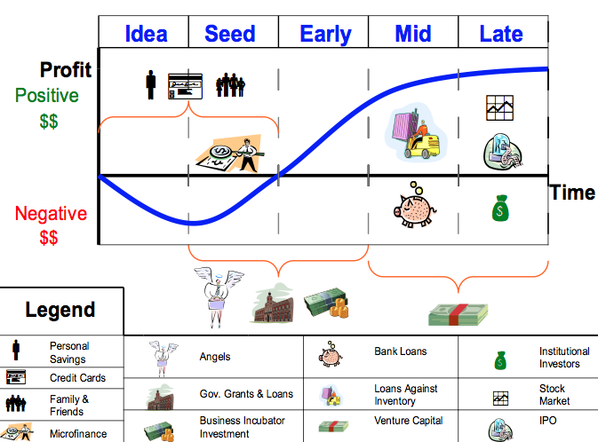
Start-UP Life Cycle
http://businessincubatorsindia.blogspot.hu/2012/04/business-incubators-how-they-help-start.html

Slide 40
Example of Exit Strategies
1. Friends and Family Financing
2. No Exit at all!
These companies have excellent cash flows and the founders have no interest in an exit.
http://www.angelblog.net/Examples_of_Exit_Strategies.html

Slide 41

Example of Exit Strategies
PlentyOfFish (POF) is an online dating service that generates revenue through advertising and premium memberships.
Freemium services such as:
Who has 'liked' a member Tinder-like,
see whether a message has been read and/or deleted.
http://www.angelblog.net/Examples_of_Exit_Strategies.html

Slide 42
Example of Exit Strategies
1. Friends and Family Financing
2. Exit
These companies were very successfully sold even before they received angel investment. Milking the cow!
- Flickr
- Club Penguin
http://www.angelblog.net/Examples_of_Exit_Strategies.html

Slide 43

Example of Exit Strategies
Stuart Butterfield was trying hard to raise some angel money for his multiplayer online game called the Game Neverending.
Selling Flickr to Yahoo for $30 million.
No other investor understood his game either; so, in a fit of despondency one weekend he decided to build a photo-sharing app instead and sell it.
http://www.angelblog.net/Examples_of_Exit_Strategies.html

Slide 44


Example of Exit Strategies
Club Penguin
An online world for 6 to 14 year olds created in 2005.
Founded in October 2005 and was sold to Disney in August 2007 for $700 million
The three founders were the only shareholders; there were no investors in the company.
http://www.angelblog.net/Examples_of_Exit_Strategies.html

Slide 45
Example of Exit Strategies
1. Friends and Family Financing
2. Angels
3. Exit
- Brightside: http://www.exits.com/blog/case-study-the-brightside-exit/
http://www.angelblog.net/Examples_of_Exit_Strategies.html

Slide 46

Example of Exit Strategies
Brightside – is a UBC spin-off that builds technology for brighter, and higher contrast, liquid crystal displays.
5 years later (2007) it was sold to Dolby Labs for $28 million
but the company was still pre-revenue and working on its first real production prototype.
http://www.angelblog.net/Examples_of_Exit_Strategies.html

Slide 47
Example of Exit Strategies
1. Friends and Family Financing
2. Angels
3. Public
4. Exit
- Hostopia: http://www.exits.com/blog/public-company-acquisitions-can-increase-business-value/
http://www.angelblog.net/Examples_of_Exit_Strategies.html

Slide 48
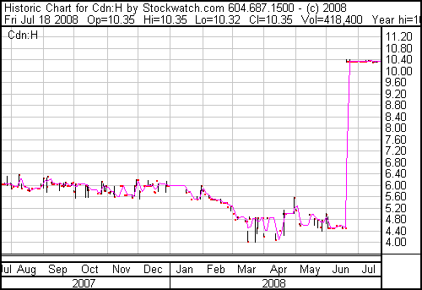
Example of Exit Strategies
Hostopia
A Toronto based web hosting company. They went public in November of 2006 raising $25 million at $6.00 per share.
In June of 2008, a US company Deluxe Corporation agreed to purchase the company for $10.55 per share.
100% more than the stock had been trading at.
Prior to the offer between $5.00 and $6.00.
http://www.angelblog.net/Examples_of_Exit_Strategies.html

Slide 49
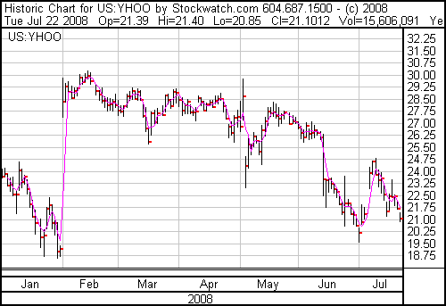
Example of Exit Strategies
Yahoo
Microsoft’s offer to buy Yahoo on January 31, 2008
$31.00 per share a 62% premium over what the stock had been trading at.
As hopes for the acquisition faded, the stock dropped back to just about where it was before the announcement.
http://www.angelblog.net/Examples_of_Exit_Strategies.html

Slide 50
Example of Exit Strategies
1. Friends and Family Financing
2. Angels
3. Venture Capital Series A
4. Exit
Supercomputing giant Cray acquiring OctigaBay high-performance computing (HPC) market: http://www.technewsworld.com/story/32987.html
http://www.angelblog.net/Examples_of_Exit_Strategies.html

Slide 51

Example of Exit Strategies
OctigaBay – was a Vancouver company, founded in 2001, that developed an innovative, high-performance computing system based on Linux and AMD processors.
It was acquired by Cray in February 2004 for $115 million – three years after founding.
http://www.angelblog.net/Examples_of_Exit_Strategies.html

Slide 52
Thank you!
Brought to you by EIT Digital Master School @Eötvös Lorand University
Find me at: anna.reale@inf.elte.hu

